Slide 1
Peninsula Lake Causation Study
Stakeholder Meeting
November 8, 2019
Kris Hadley, Neil Hutchinson (Hutchinson Environmental Sciences Ltd.)
In collaboration with the District Municipality of Muskoka

Slide 2
Schedule
Presentation
Background to study and study scope
What do we know already ?
What do we want to learn?
Formal Question and Answer

Slide 3
Background
Request for Proposal issued by the District Municipality of Muskoka on August 13, 2019
Goal is to develop an evidence-based, defensible approach to determine the cause(s) and contributing factors that are impacting water quality focused on Peninsula Lake but adaptable to other lakes listed as vulnerable under the Muskoka Official Plan
Hutchinson Environmental Sciences Ltd. awarded the project

Slide 4
Project Team
Hutchinson Environmental Sciences Ltd. (HESL) is a team of 9 experienced scientists specializing in aquatic environmental science for over a decade and head office in Bracebridge
HESL’s areas of expertise:
Lake and Watershed Management,
Algal and Nutrient Dynamics
Water Quality Assessment and Modelling,
Receiving Water and Assimilative Capacity Studies, and
Peer Review, Public Engagement/Facilitation and Scientific Synthesis.
Notes:
Related project experience: review of managing shoreline development on inland lakes (MOECC), Oak Lake Water Quality Management Study

Slide 5
Workplan
Start-up meeting ✓
Compile and review existing data - Ongoing
Background Review
Field program ✓
Water quality sampling (October 2019) ✓
Gap analysis and establish parameters of interest
Phosphorus budget
Development of Causation Study Pilot Program – Weight of Evidence

Slide 6
Scheduling

Slide 7
What Might Cause an Algal Bloom?
No definitive cause – they are favoured in nutrient rich waters –but not in low nutrient waters like Peninsula Lake.
Increase in total phosphorus in surface water
Land use changes, point sources
Warmer, more stable water column favours cyanobacteria
Algal species that take phosphorus from enriched sediments
Other ions in water (iron)
Loss of oxygen in deep water
Some lakes have deep water anoxia
Warming climate promotes anoxia (earlier stratification)
Anoxia promotes phosphorus release from bottom sediments (internal load)
Some algal forms (cyanobacteria) can migrate to deep water to take up this phosphorus then bloom on surface

Slide 8
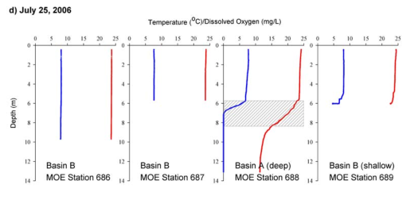
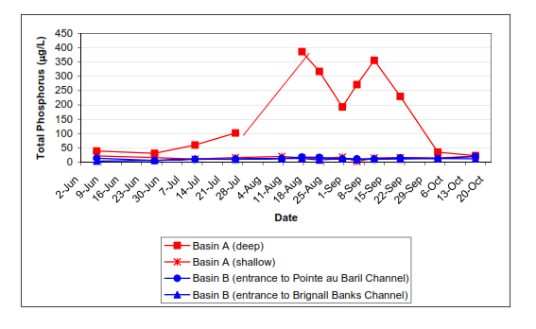
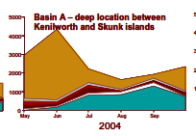
What Might Cause an Algal Bloom?
Loss of oxygen in deep water – Sturgeon Bay Example
Deep basin loses oxygen in July
Deep Basin shows internal load in August and September
Deep Basin shows cyanobacterial dominance in August and September

Slide 9
Background Review
Water quality data
Lake Partner Program Phosphorus Data (2002-2017)
Citizen Science Data – Pending
Ministry of Environment, Conservation and Parks (MECP)
District Municipality of Muskoka (DMM) data
GIS data
DMM in-house data
Ontario Flow Assessment Tool (OFAT) data
Historical Data
Information on Past Algal Blooms (Engage Muskoka)
Public Survey Posted at: https://www.engagemuskoka.ca/protecting-muskokas-vulnerable-lakes-causation-studies

Slide 10
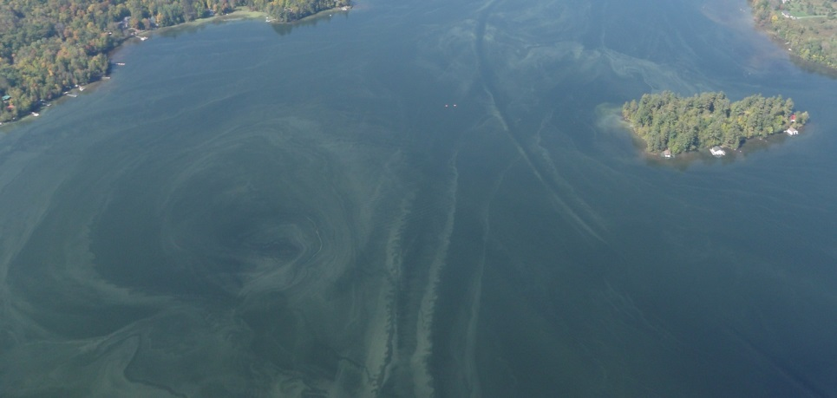
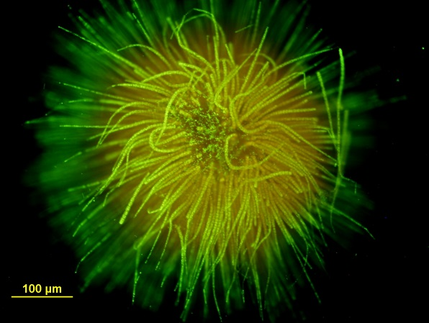
Peninsula Lake Algal Bloom
Species is Gloeotrichia echinulata
Also bloomed on Peninsula Lake in mid-1990s
Complex life cycle summarized briefly as:
1) germination on the sediment,
2) growth on the sediment,
3) gas vesicles formation and migration into the water column,
4) growth and division in the water column,
5) formation of resting stages, called akinetes,
6) sinking of akinetes out of the water column to the sediment, and
7) resting and maturation of the akinetes on the sediment
Brian Tapley
Wikipedia.org

Slide 11
Historical Total Phosphorus

Slide 12
Monitoring Plan
Goal: Establish oxygen status of the deep water and determine if internal loading is a factor in Peninsula Lake
Water Quality Sampling
Sampling Locations
2 sampling locations on Peninsula Lake, deep spot in each basin
Sampling frequency
1 event: October 2019

Slide 13
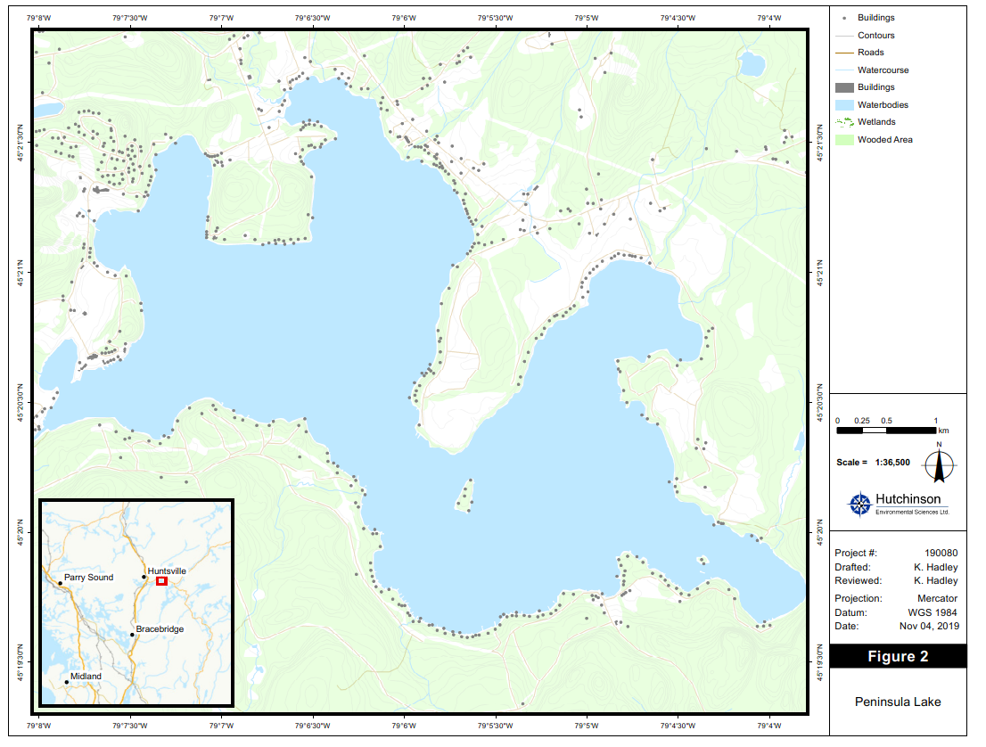
DMM and HESL Sites
U Waterloo (2012)
LPP

Slide 14
Monitoring Plan
Water Quality Parameters
General chemistry, nutrients and metals
Phosphorus and iron from bottom waters if dissolved oxygen is low
Field measurements of pH, conductivity, temperature and dissolved oxygen
Notes:
How best to install logger? Ask residents if a buoy will be okay

Slide 15
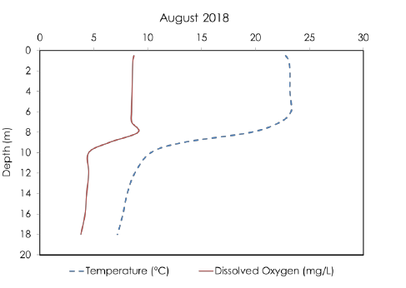
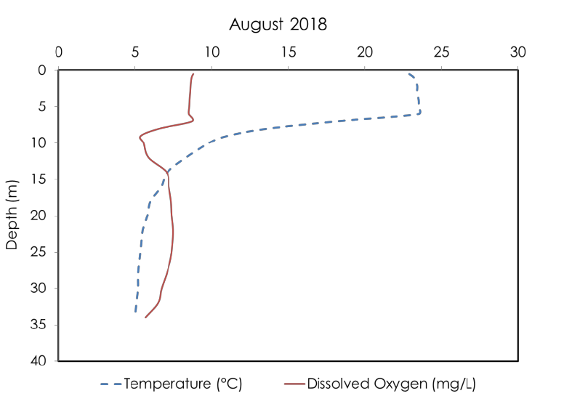
Dissolved Oxygen Profiles – DMM
Peninsula Lake - East
Peninsula Lake - West

Slide 16
Dissolved Oxygen – Fall 2019
Peninsula Lake - East
Peninsula Lake - West

Slide 17
Phosphorus Budget
Export coefficient modelling
Quantify nutrient loading from internal (sediments) and external sources (overland runoff, septic systems, precipitation)

Slide 18
Phosphorus Budget
DMM Water Quality Model
Mass balance model that estimates natural and human sources to predict phosphorus concentrations
Allows for management to focus on greatest potential sources of nutrients and to define conditions according to water quality guidelines

Slide 19
Muskoka Water Quality Model
Shoreline
Development
Septic systems Urban runoff
Point sources
Geology
Wetlands
Land Use
Atmospheric Input From
Deposition Watershed
Anthropogenic Natural (background)
Phosphorus Phosphorus
Hydrology
Phosphorus in Lake
Lake Morphometry
Hypolimnetic Oxygen

Slide 20
Causation Study
Focused on estimating the relative importance of ecology, climate and development on the re-emergence of cyanobacteria blooms in Peninsula Lake, to inform on the need for the development of additional monitoring programs, septic surveys or other special studies
Notes:
Not a data collection exercise

Slide 21
How Can you Help?
Engage Muskoka Survey
Provide information on the history of Peninsula Lake, specifically on the history of algal blooms in the lake
Citizen Science Data
Data on water quality or climate that could be incorporated into the Causation Study

Slide 22
How Will Your Input Be Used?
To inform our Weight of Evidence approach to connect changes in climate, water quality and development to recent algal blooms in Peninsula Lake

Slide 23
Weight of Evidence Approach

Slide 24
Weight of Evidence Approach
 | Lines of Evidence
Potential Causes of Algal Blooms | Increased Bloom Frequency | Benthic vs Planktonic Species | Documented Warmer Water | Documented Increase in Storm Intensity | Documented Warmer Air | Documented Increase in Low Wind Periods | Measured Internal Load | Periodic Anoxia | Documented Increase in Anoxia | Documented Increase in TP | Increased Watershed Disturbance | Location of Blooms | Extent of Blooms
Climate Change - Warmer/Calmer Water | X | P | X |  | X | X
Climate Change - Enhanced Internal Loading | X | P | X |  | X |  | X | X | X | X
Sediment Sources |  | B | X |  | X |  | X | X |  |  | X
Local Landscape Disturbances |  | P |  | X |  |  |  |  |  | X | X | X | X
Natural Internal Loading |  | P |  |  |  |  | X | X
Increased TP Load - Septics | X | P |  |  |  |  |  |  | X | X |  | X | X
Increasd TP load- Watershed | X | P |  | X |  |  |  |  |  | X | X | X | X
Increased TP Load - Specific Land Uses |  | P |  | X |  |  |  |  |  | X | X | X | X
Benthic = Gloeotrichia

Slide 25
Thank you
Emily Crowder
District Municipality of Muskoka
Phone: (705) 645-6764 x4313
Emily.Crowder@muskoka.on.ca
Engage Muskoka Survey
https://www.engagemuskoka.ca/protecting-muskokas-vulnerable-lakes-causation-studies

